Slide 1

LatentGuard: Adaptive Dual Layer WAF for Anomaly and Threat Detection
To Safely detect and mitigate both known & unknown attacks on Web Applications using unsupervised machine learning techniques in a layered architecture.
Students
Syed Shaheer Khalid (SP23-BCT-048)
Javaria Maqbool (SP23-BCT-023)

Slide 2
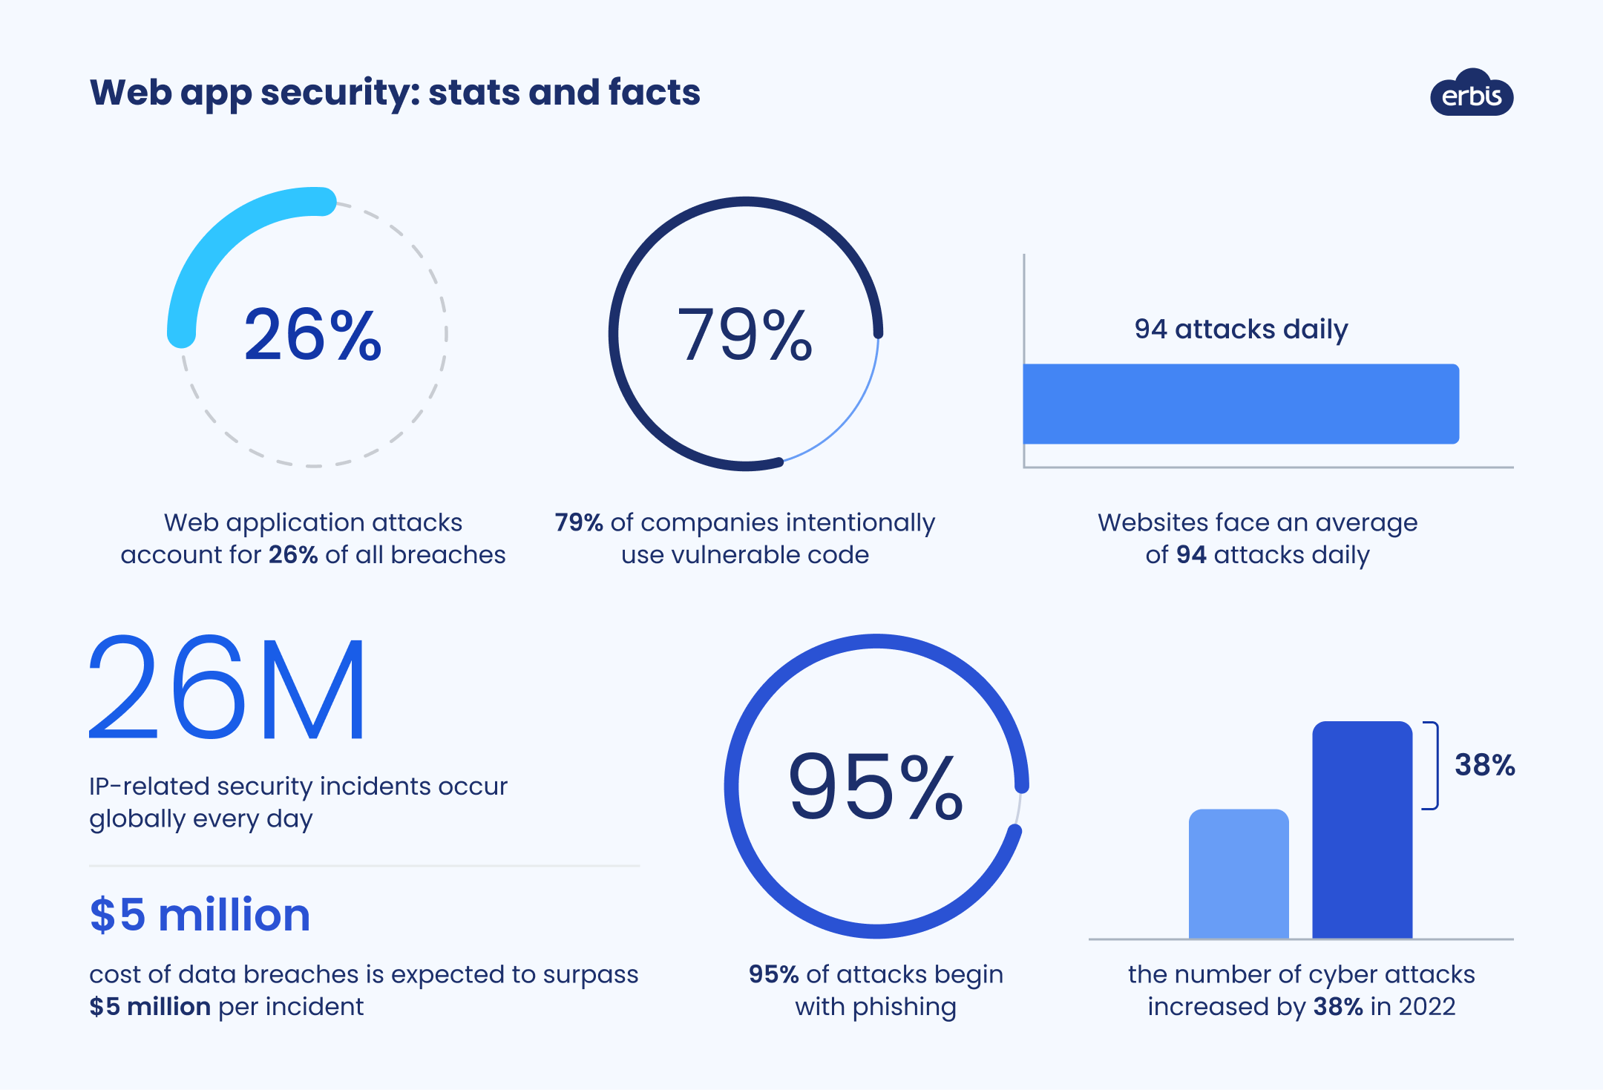
Problem Statement
Modern web applications account for a large share of global internet traffic (60 - 62%) and are continuously exposed to sophisticated attacks such as SQL injection, XSS, command injection, and zero-day exploits.
Traditional signature-based & AI detection rely on known attack patterns and hence, fail against unknown or obfuscated attacks.
As web applications grow more dynamic and attack techniques evolve rapidly, there is a critical need for an intelligent and adaptive WAF that can detect zero-day attacks.

Slide 3
The Evolving Threat Landscape: Gaps in Existing Solutions
Types / Names | Strengths | Weaknesses
Cloud-based (Azure, AWS, GCP, Cloudflare) | Managed Service Enriched Threat Intelligence. Great detection with models trained on Supervised learning | Expensive, especially for countries like Pakistan. Single point of failure Cannot detect unknown attacks.
On-Prem – Paid (F5 Big-IP Advanced WAF, Barracuda, Fortinet Fortiweb) | High security efficacy (Behavioral analytics, ML, Deep inspection) Flexible deployment | Costly, higher price point and steep learning curve for config. Requires experienced operators to configure. Cannot detect unseen attacks.
On-Prem – Open-Source (ModSecurity, NAXSI) | Lightweight Free & Customizable | Requires significant manual rule customization to reduce false positives. Lacks ML, Bot mitigation Relies on static rule-based detection

Slide 4
Key Objectives for a Smarter WAF
Develop an unsupervised deep autoencoder trained solely on benign HTTP traffic to detect anomalies via high reconstruction errors and establish an effective threshold for normal vs. anomalous requests.
Integrate HDBSCAN clustering on the autoencoder’s latent representations to group similar anomalies, filter noise, and distinguish benign-unusual traffic from genuine malicious attacks.
Implement a real-time hybrid decision engine that allows fast rule-based checks first.
Design an AI-driven mechanism that extracts attack patterns from anomalies and clusters, then uses LLMs to automatically generate executable ModSecurity compatible WAF rules for emerging threats.

Slide 5
Solving a problem: Why an Unsupervised AI-Assisted WAF
The core complex problem being solved by LatentGuard is real-time detection and mitigation of zero-day web attacks in high-volume, dynamic web traffic environments, where traditional rule-based Web Application Firewalls (WAFs) fail due to evolving threats, high false positive rates, and inability to handle unknown attack patterns.
Real-time Anomaly Detection
Hybrid AI/Rule-Based Approach
The system performs real-time analysis of streaming HTTP/HTTPS requests, a computationally intensive task requiring efficient algorithms and architecture.
Combining fast, deterministic rule-based checks with a Comprehensive AI component for unseen attack cases provides a novel and robust detection mechanism.
Scalability and Deployment Agnosticism
Explainable AI in Cybersecurity
The design prioritizes scalability to handle high traffic loads and offers deployment flexibility without code changes, demonstrating advanced system design principles.
Integrating explainability into the AI decision process is a cutting-edge challenge in ML, ensuring transparency and trust in automated security decisions.

Slide 6
Methodology: A Step-by-Step Approach
Pre-Filtering AI-generated + OWASP CRS rules + threat intel Immediate block/challenge for known threats
Feature Engineering Extract behavioral (method, length, headers) & content features (tokens, n-grams, char ratios) Normalize → high-dim vector
Anomaly Detection Deep autoencoder trained only on benign traffic High reconstruction error → flag as anomalous
HDBSCAN Clustering Cluster latent representations of anomalies Dense = benign-unusual | Noise/outlier = attack
Final Decision Malicious only if autoencoder + HDBSCAN both agree Full logging (error, cluster, features) for explainability
Self-Learning Loop Mine confirmed attacks → extract patterns → LLM generates new rules Human review → deploy → system evolves

Slide 7
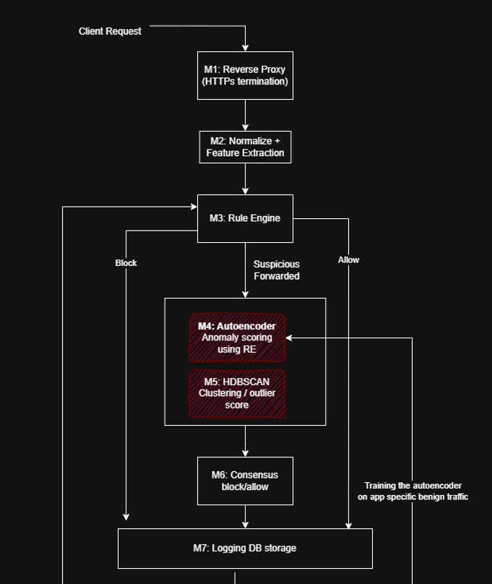
Methodology: A Step-by-Step Approach
Datasets such as CSIC 2010, HTTPParams, ECML/PKDP, XSS will be used for training.
OWASP CRS core rule sets will establish the baseline for first level filtering.
The system adapts continuously to traffic and the feedback provided by our Layered Architecture.

Slide 8
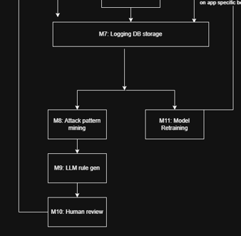
Methodology: A Step-by-Step Approach

Slide 9






Leveraging Cutting-Edge Tools & Technologies
The successful implementation of our AI-assisted WAF relies on a strategic selection of robust and scalable tools and technologies.
Golang – net/http or Gin
Python – PyTorch / HDBSCAN
WAF core logic http logic. Very fast, ideal for high-throughput request processing. Gin is a great Framework for building the lightweight WAF reverse proxy. Best for strong support for web ecosystem.
Used for implementing Deep Fully connected encoders and HDBSCAN for clustering.
Large Language Model: Meta-Llama-3.1-8B-Instruct
Docker/Kubernetes
Selected as the Model that converts mined attack patterns into ModSecurity-compatible WAF rules. Follows instruction clearly, and has a structured output
Containerization and orchestration for deployment flexibility and scalability across various environments (on-premises, cloud, hybrid).
Elasticsearch
Grafana/Kibana
Centralized log storage and analysis for asynchronous event logging and real-time monitoring of WAF activities.
Data visualization dashboards to provide insights into WAF performance, blocked attacks, and decision rationales.

Slide 10
Expected Outcomes: A Secure and Insightful Future
This project aims to deliver a tangible and impactful solution, significantly contributing to the field of web security and providing a strong foundation for future research.
Key Deliverables
Relevance and Impact
Working WAF Prototype: A functional reverse proxy capable of intercepting, analyzing, and mitigating web attacks.
AI Detection Module: A trained and optimized machine learning model for detecting both known and unknown errors.
Deployment Framework: Containerized WAF for easy deployment in diverse environments (on-premise, cloud, hybrid).
Centralized Logging & Dashboard: A system for comprehensive event logging and a user-friendly dashboard for real-time visualization and policy management.
Documentation: Detailed technical documentation covering architecture, implementation, deployment, and usage.
Enhanced Security Posture: Provides a proactive defense against evolving web threats, reducing the attack surface for web applications.
Reduced Operational Overhead: Automates detection and decision-making, minimizing the need for constant manual intervention.
Deployment Flexibility: Caters to a broad range of organizational needs, from small businesses to large enterprises with complex infrastructures.
Explainable AI in Practice: Demonstrates how AI can be effectively and transparently applied in critical security domains.
Educational Contribution: Serves as a practical example of applying advanced computer science concepts to real-world cybersecurity challenges.

Slide 11
Key Takeaways & Future Directions
The AI-assisted WAF project demonstrates a practical and innovative approach to enhancing web application security. It provides a robust, deployment-agnostic solution that intelligently combines rule-based filtering with machine learning for adaptive threat detection.
Future Work
Context-Aware Policies: Develop more sophisticated policy engines that adapt security rules based on application context, user behavior, and threat intelligence feeds.
Multi-Cloud Integration: Enhance deployment capabilities to support specific features and APIs of various cloud providers (e.g., Azure, GCP).
Open-Source Contribution: Consider open-sourcing components of the WAF to foster community contributions and accelerate development.
Automated Response Actions: Explore integration with other security tools for automated incident response, such as IP blocking at the network perimeter or dynamic patching.
Performance Optimization: Further optimize the AI component for even lower latency and higher throughput, potentially exploring hardware acceleration.

